Slide 1
FWD Project
TOGAF 9 - Core Diagrams Class Diagram Phase C – Information Systems Architectures

Slide 2
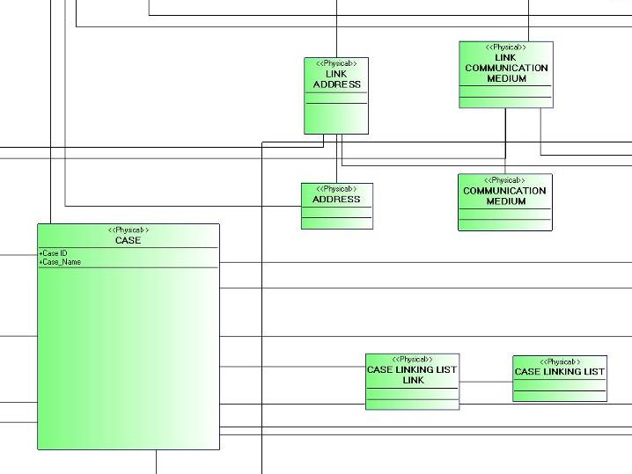
Class Diagram

Slide 3
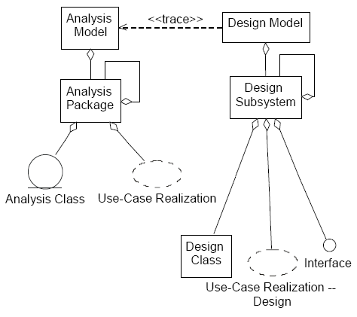
Class Diagram

Slide 4
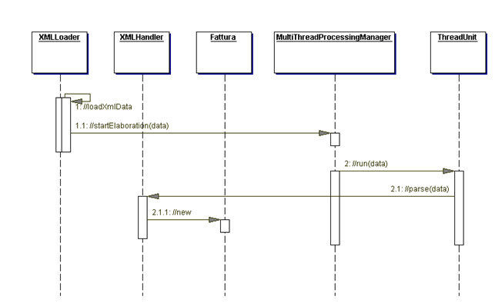
Class Diagram

